Slide 1
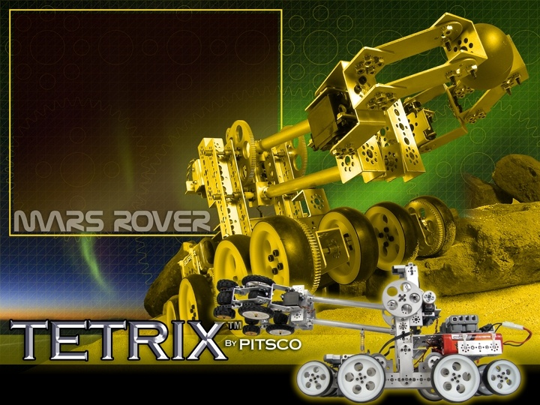
What is TETRIX?
If you can dream up a robot design, you can build it with the TETRIX Robotics Design System.

Slide 2
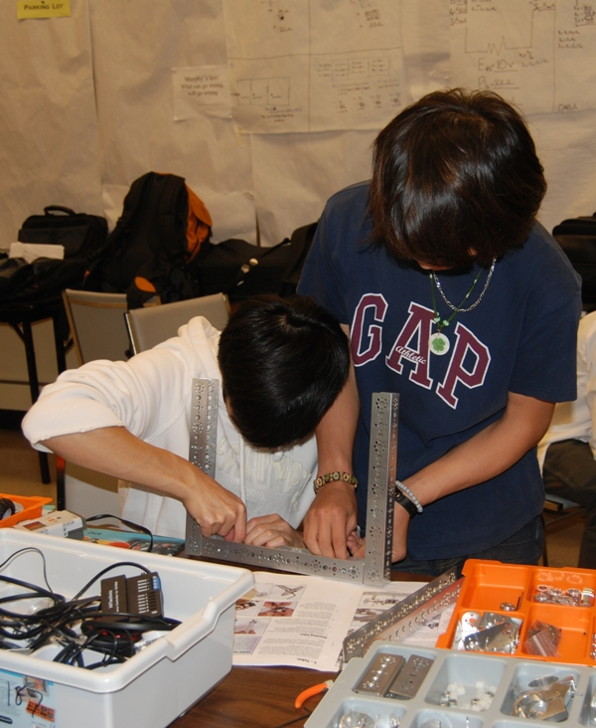
My high school students can build Tetrix Robot

Slide 3
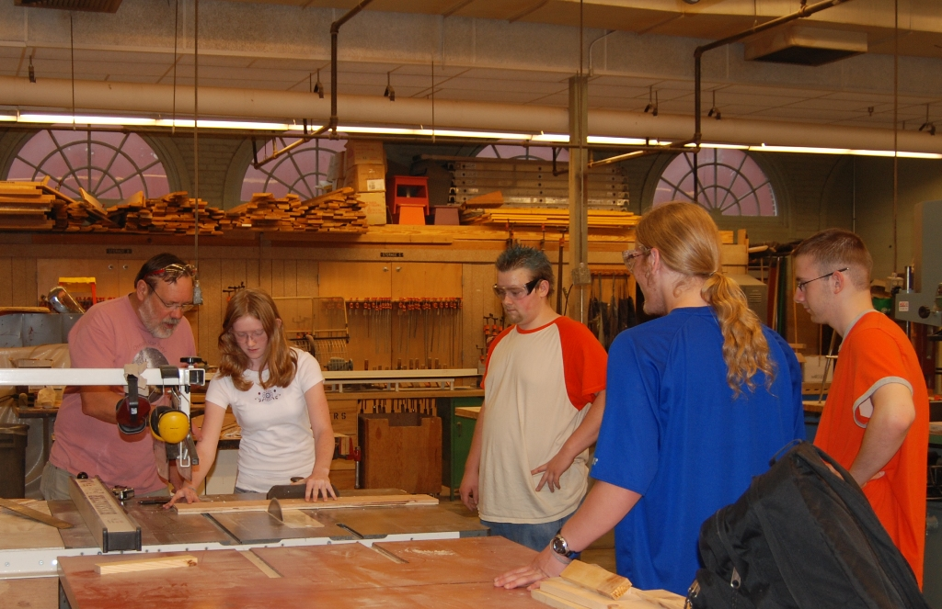
John De Lacy

Slide 4
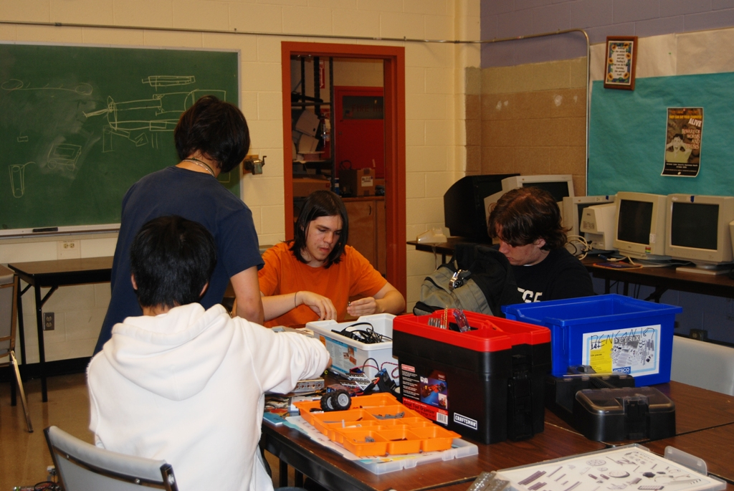

Slide 5
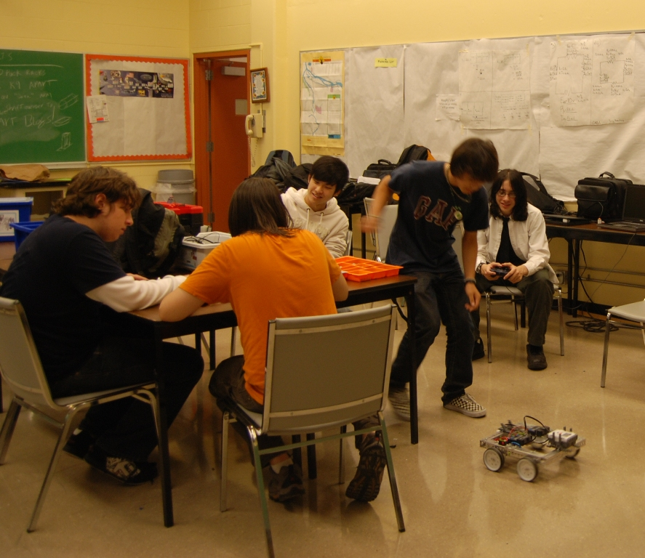

Slide 6
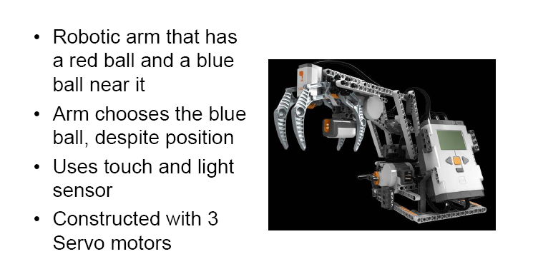

Slide 7
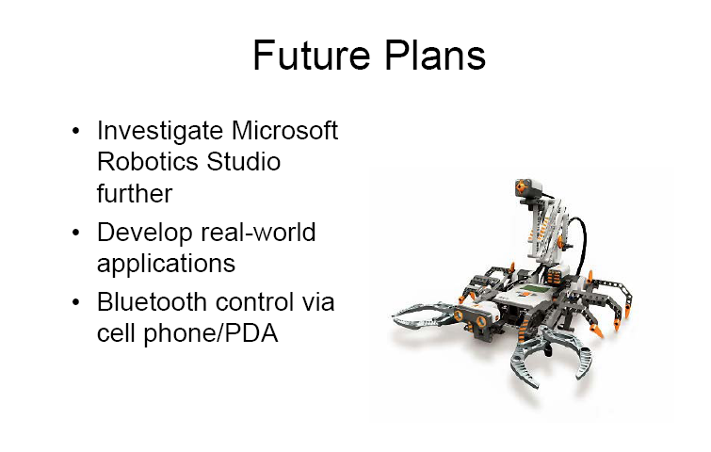

Slide 8
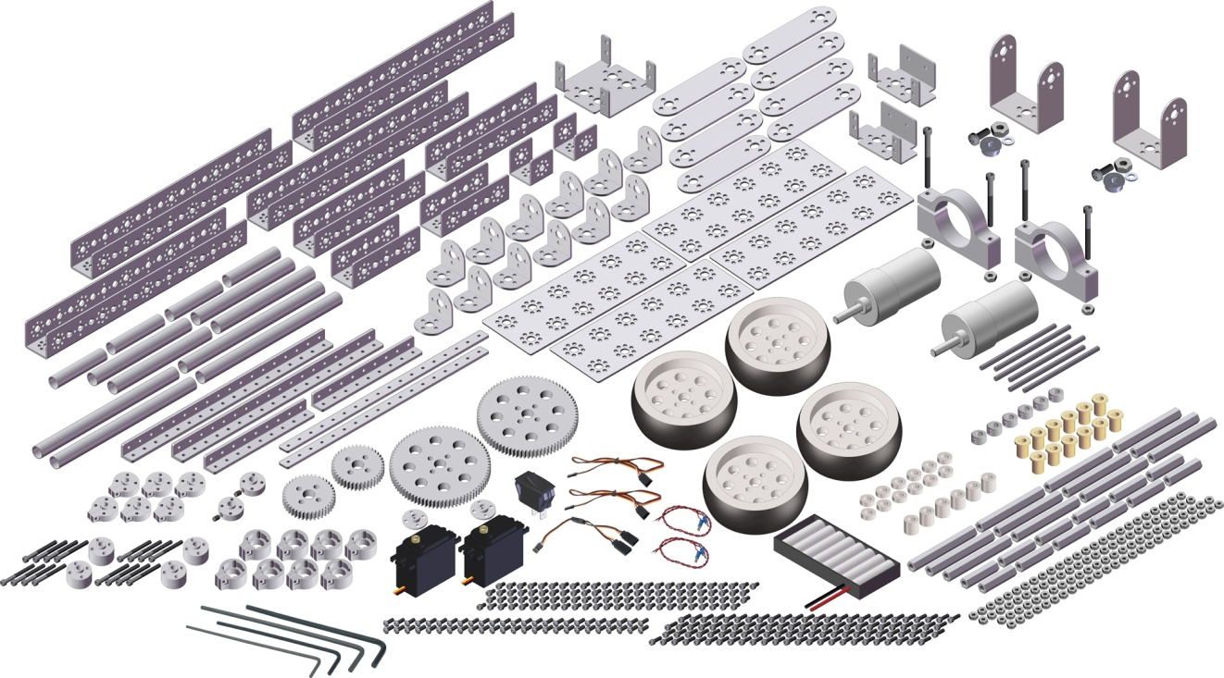
What gives the TETRIX Robotic Design System an edge over the competition?
Base Set
39108 - $399

Slide 13



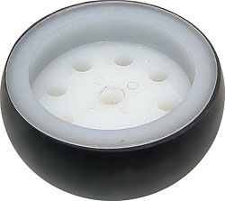

Slide 14
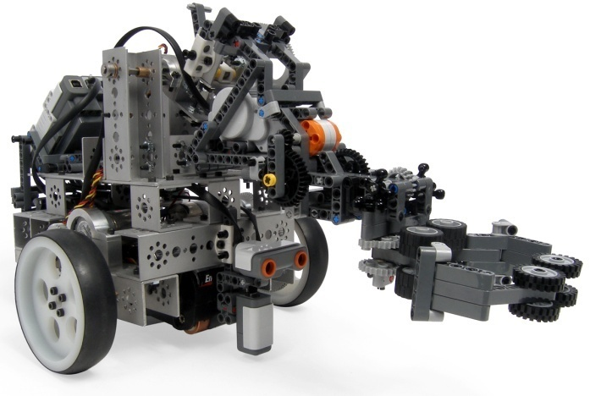
Tetrix/Lego Mobile robot with arm

Slide 15
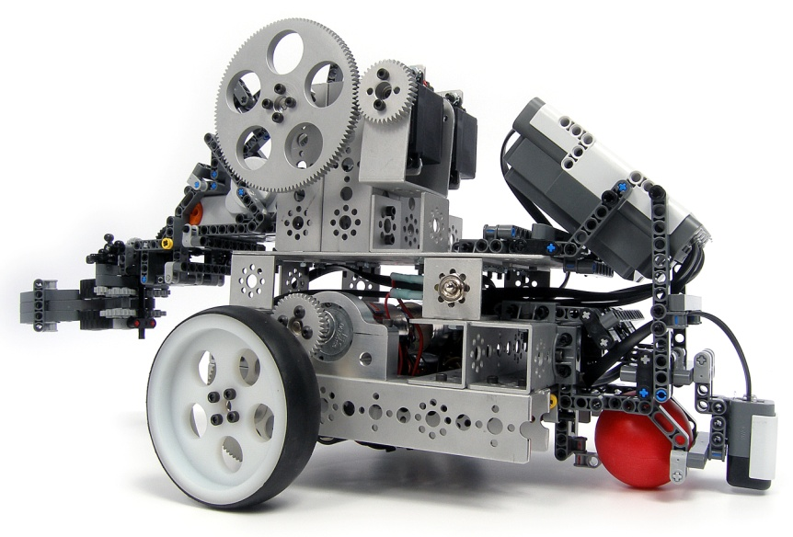
Tetrix/Lego Mobile robot with arm

Slide 16
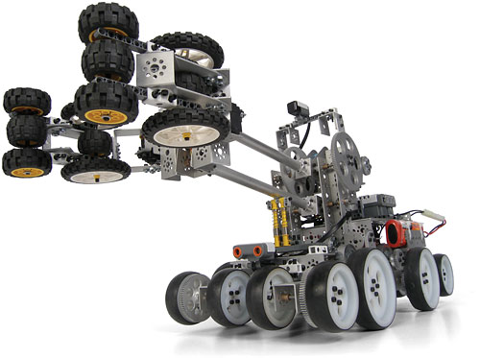

Slide 17
Many ready instructions how to build
Your resources are:
  Tetrix webpages
  Lego books and Webpages
  Lynxmotion pages
  Other robo-shops pages
  Many webpages of hobbyists
We will go quickly through a lot of information “How to do this”
You can read in more details.

Slide 18
A – Building a Basic Chassis with Indirect Drive

Slide 19
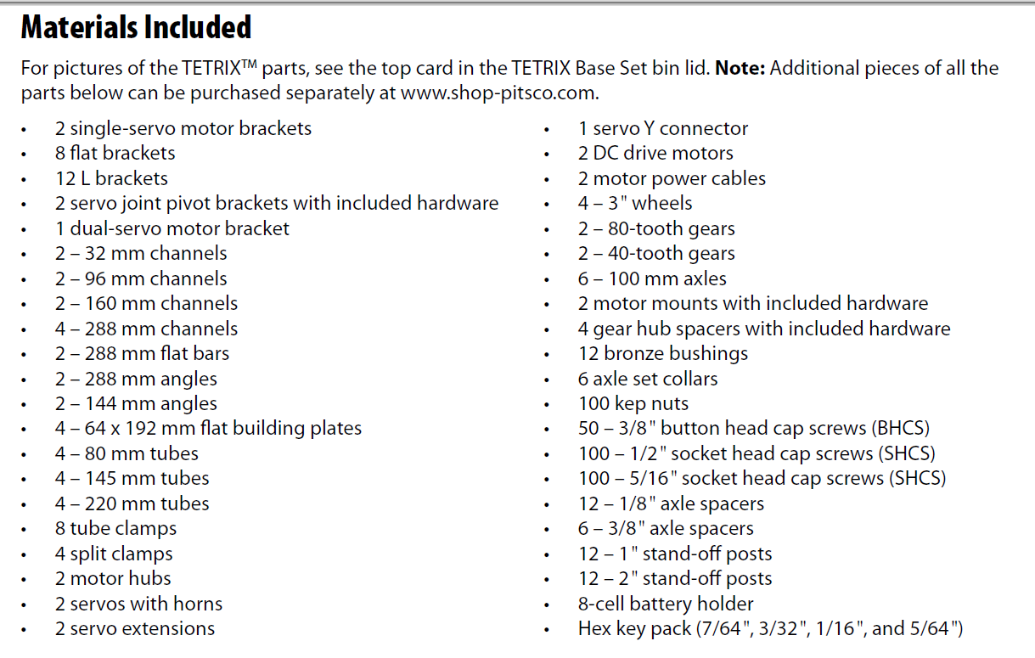

Slide 20
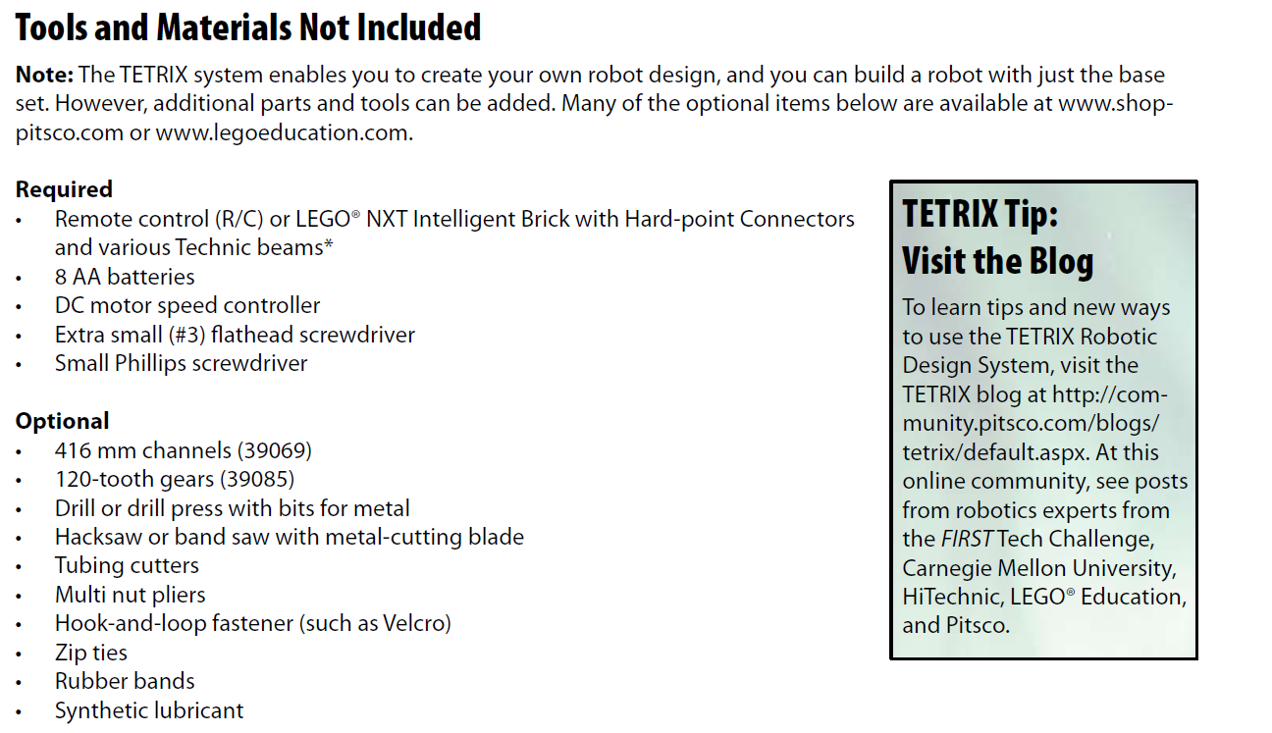
http://community/pitsco.com/blogs/tetrix/default.aspx

Slide 21
Two Modes of control for Tetrix
A robot can be operated with an R/C.
The LEGO® NXT Intelligent Brick.
  The NXT is attached with Hard-point Connectors and Technic beams, which are sold separately.

Slide 22
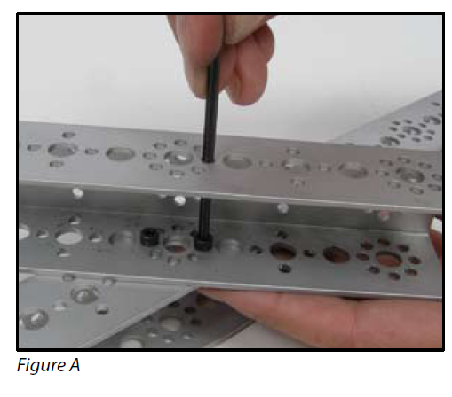
Construction Tips
Cutting metal pieces – All the aluminum structural pieces in the TETRIX Design System – such as channel, angle, or flat bars – can be cut using a hacksaw or band saw with a metal-cutting blade.
If you do cut any metal pieces, you should smooth off any burrs with sandpaper or a file.
Aligning to the holes – The trademarked hole pattern on the TETRIX structural pieces enable you to attach pieces together at an angle,
  not just horizontally and vertically from each other.
For example, you can attach a piece at 45° (Figure A).

Slide 23
Tightening screws
The TETRIX hole pattern is on all sides of the structural pieces – making it easy to tighten the screws with the hex wrench by simply putting the wrench through the other side as shown in Figure A.
The screws in the TETRIX system are fastened with kep nuts
Kep Nuts feature a toothed side.
This toothed side should face toward the screw.
So the teeth can grab onto the metal, which helps it hold better.

Slide 24
Selecting screws: SHCS ½, SHCS 5/16 and BHCS
There are two sizes of socket head cap screw (SHCS) in the base set: 1/2" and 5/16".
As a rule, use the 1/2" screws for joining two structural elements together.
Use the shorter 5/16" screws to:
  attach servos and tube clamps and
  when there isn’t much clearance on the inside of parts.
The button head cap screws (BHCS) are useful when the SHCSs might stick out too far from the body and rub against a moving part, such as a gear.

Slide 25
Tightening split clamps and tube clamps
For maximum clamping grip, you need to tighten the clamp screws in stages.
  First, snug the set screw on the clamp – but not too tight.
  Then, attach the clamp to the structural element with four screws and tighten them partway.
  Finish tightening the set screw, and then finish tightening the four other screws.
This will keep the clamp in the proper shape for attaching to structural elements while ensuring proper grip on axles and tubes.

Slide 26
A – Building a Basic Chassis with Indirect Drive
The chassis constructed in this section is a basic rectangular chassis with four wheels and two drive motors.
This provides basic construction information.
You can do modifications:
  use different channel pieces,
  have three wheels instead of four,
  or otherwise change this chassis to fit your design.

Slide 27
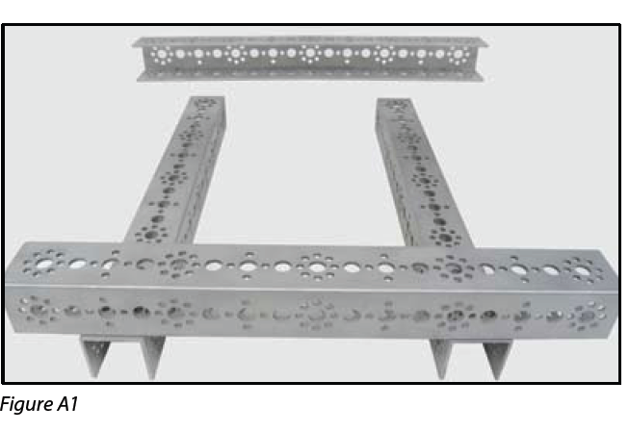
Chassis
STEP 1)
Set two 288 mm channel pieces side by side with the open end of the U-shape facing down.
Set two more 288 mm channel pieces across the first two, but with the open end of the U facing in toward each other
(Figure A1).

Slide 28
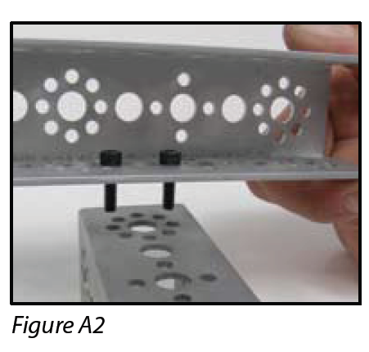
STEP 2)
Align the holes of the top channels to the holes of the bottom channels where you’d like them to be
  (in the model pictured, the top channels are fastened at the four large holes from each end to create a bumper).
At each corner, drop two SHCSs down through the two small holes on either side of the large hole
(Figure A2).
STEP 3)
Thread the kep nuts on the end of the screws.. Using the 7/64" hex wrench, tighten the screws.
STEP 4)
Repeat Steps 2-3 for the other three corners.

Slide 29
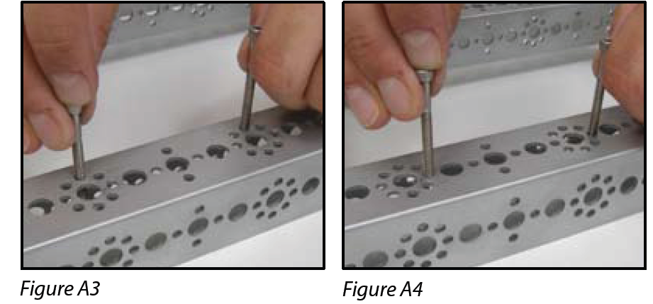
Motor Mounts and Drive Wheels
In this model, the motors are not directly driving the wheels but instead are turning gears that will connect with gears on the wheels.
STEP 1)
Set one motor mount along the top of one bottom piece of channel.
Determine where you want the motor to rest – be sure to allow space for the wheel and the gears.
Note that the motor mount holes align with the smaller holes on the channel and that you can use any two parallel holes in the circle
(Figures A3 and A4).

Slide 30
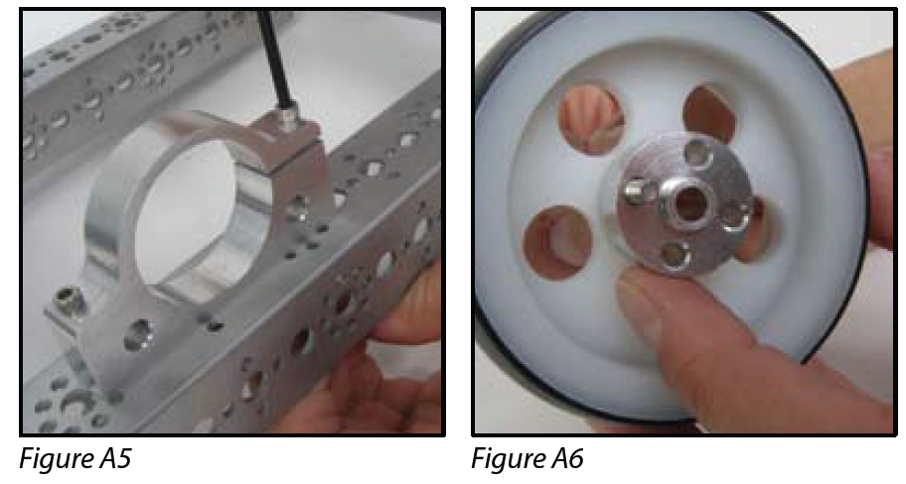
STEP 2) Using the 1-1/2" screws that come with the mount, bolt down the unclamping end. Bolt the other side, but do not tighten it all the way
(Figure A5).
STEP 3) Place a gear hub spacer on the center hole of a wheel and line up their holes.
Thread a 1-1/4“ screw that comes with the hub through a small hole on the other side of the wheel (Figure A6).

Slide 31
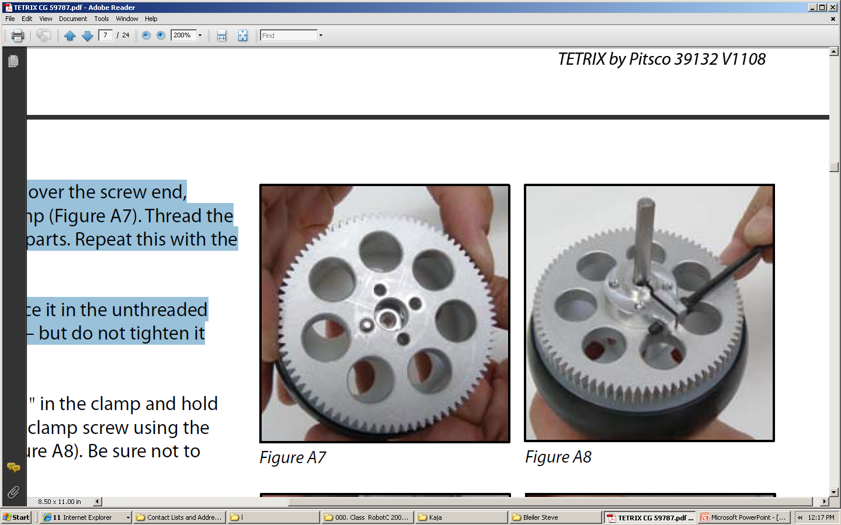
STEP 4) Drop an 80-tooth gear over the screw end, followed by a split clamp (Figure A7).
Thread the screw through all four parts.
Repeat this with the other three screws.
STEP 5) Using a 1/2" SHCS, place it in the unthreaded side of the split clamp – but do not tighten it very much.

Slide 32
STEP 6) Slide an axle about 1/4" in the clamp and hold it while tightening the clamp screw using the 7/64" hex wrench (Figure A8).
  Be sure not to overtighten it.

Slide 33
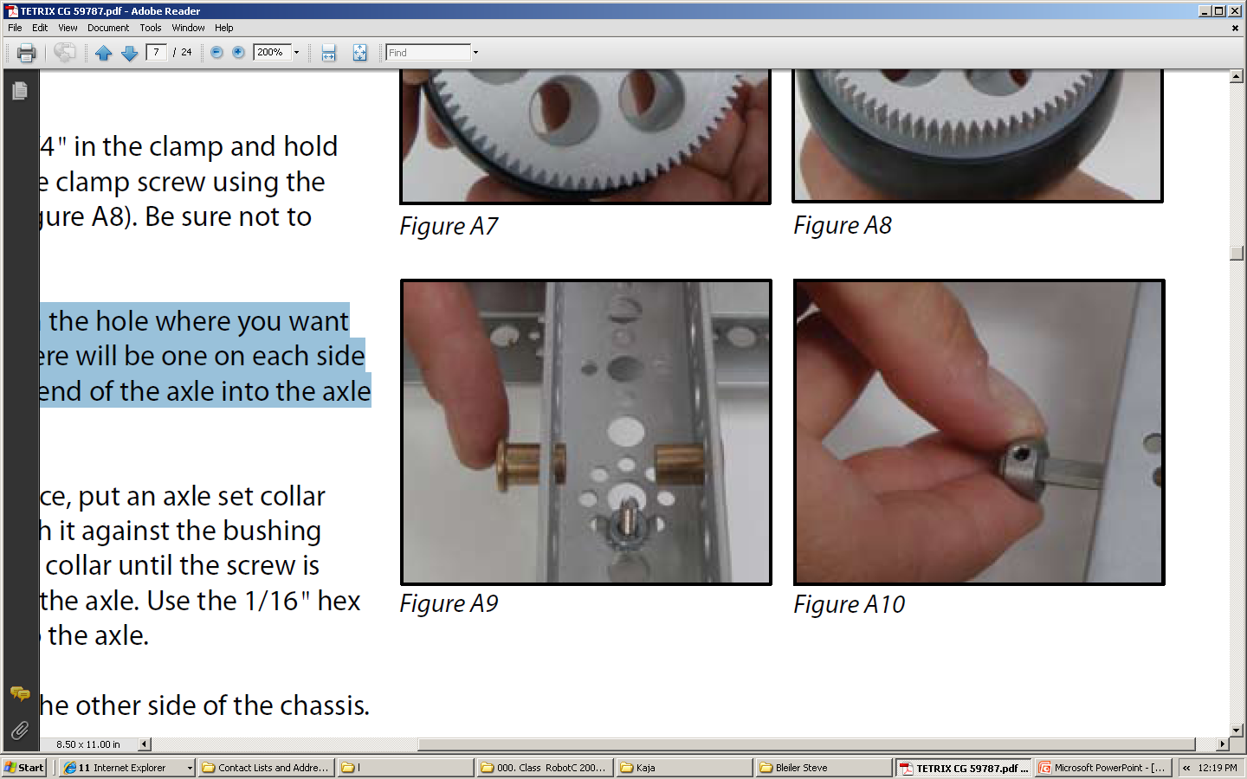
STEP 7)
Insert the bushings in the hole where you want to place the axle – there will be one on each side
(Figure A9).
Push the end of the axle into the axle hole.

Slide 34
STEP8)
To lock the axle in place, put an axle set collar over the end and push it against the bushing
(Figure A10).
Turn the collar until the screw is facing the flat side of the axle.
Use the 1/16" hex wrench to secure it to the axle.
STEP9) Repeat Steps 1-8 for the other side of the chassis.

Slide 35
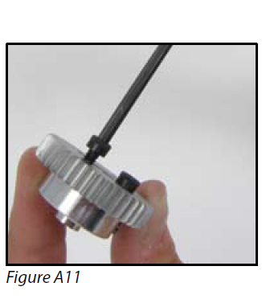
Motors and Gears
STEP 1)
Attach a 40-tooth gear to a motor hub using four 1/2" SHCSs
(Figure A11).
If you think the screw heads might rub against other parts, you can use BHCSs instead.
STEP 2)
Take a DC motor and place it through the back of the motor mount so the motor shaft points toward the wheel.

Slide 36
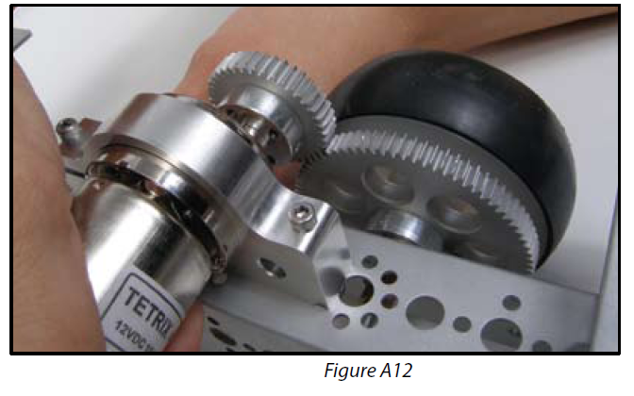
STEP 3) Take the gear assembly and slide it on the motor shaft with the gear facing out.
Adjust the motor until its gearbox is centered in the motor mount. Slide the gear assembly on the motor shaft until the 40-tooth gear is aligned with the 80-tooth gear (Figure A12).
Tighten the hub screw with a 3/32" hex wrench.
STEP 4) Turn the motor until the 40-tooth gear meshes with the 80-tooth gear (Figure A12). Tighten the clamping end of the motor mount with the 7/64“ hex wrench.
STEP 5) Repeat Steps 1-4 for the other side of the chassis.

Slide 37
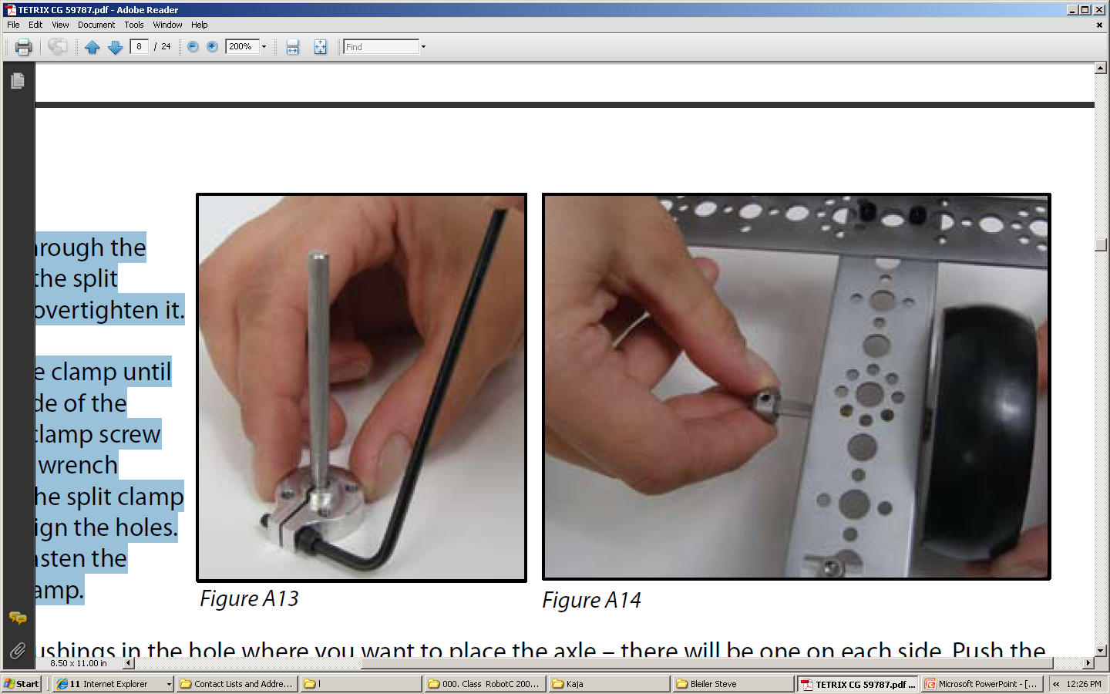
Back Wheels
Back Wheels
STEP 1)
Place a 1/2" SHCS through the unthreaded side of the split clamp – but do not overtighten it.
STEP 2)
Slide an axle into the clamp until flush with the flat side of the clamp.
Tighten the clamp screw using the 7/64" hex wrench
(Figure A13).
Place the split clamp on the wheel and align the holes.
Use 1/2" SHCSs to fasten the wheel to the split clamp.

Slide 38
STEP3)
Insert two bronze bushings in the hole where you want to place the axle – there will be one on each side.
Push the end of the axle into the axle hole.
Lock the axle in place by placing an axle set collar over the end and pushing it against the bushing (Figure A14).
Turn the collar until the screw is facing the flat side of the axle.
Use the 1/16" hex wrench to secure it to the axle.
STEP 4)
Repeat Steps 1-3 for the other side.

Slide 39
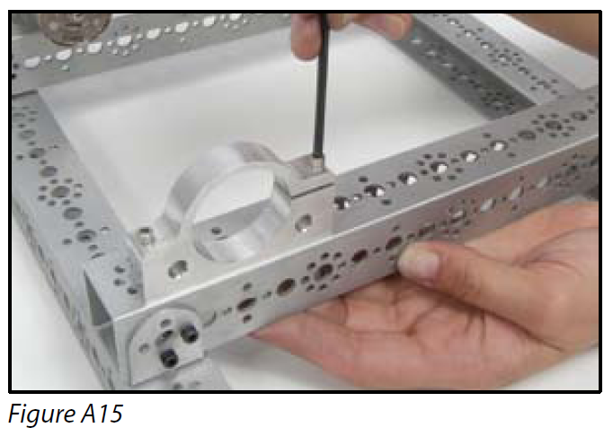
Direct Drive Alternative
With direct drive, small wheels need to be mounted under the chassis.
Be sure to plan for this when constructing the chassis:
  so the channel pieces are oriented with the open part
  or one of the two sides facing up
    (the model shown uses angle brackets to construct such a chassis).
STEP 1) Set a motor mount on one bottom piece of channel.
Determine where you want the motor to rest (Figure A15).
Note that the motor mount holes align with the smaller holes on the channel.

Slide 40
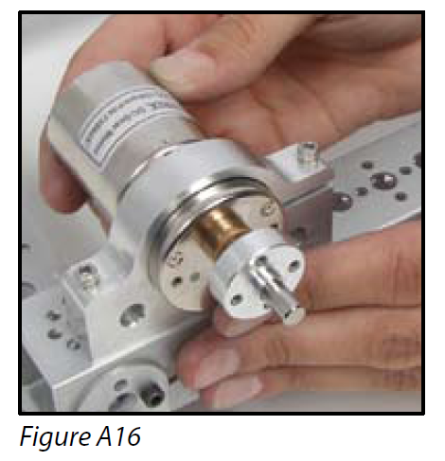
STEP 2) Using the 1-1/2" screws that come with the mount, bolt down the unclamping end.
  Bolt the other side, but do not tighten it all the way.
STEP 3) Slide a motor hub over a DC motor shaft; tighten the hub’s screw. Slide the motor into the motor mount with the shaft and hub facing out.
Adjust the motor until the gearbox is centered in the motor mount and the motor shaft is at the bottom of the mount (Figure A16).
  Tighten the clamping end of the motor mount.

Slide 41
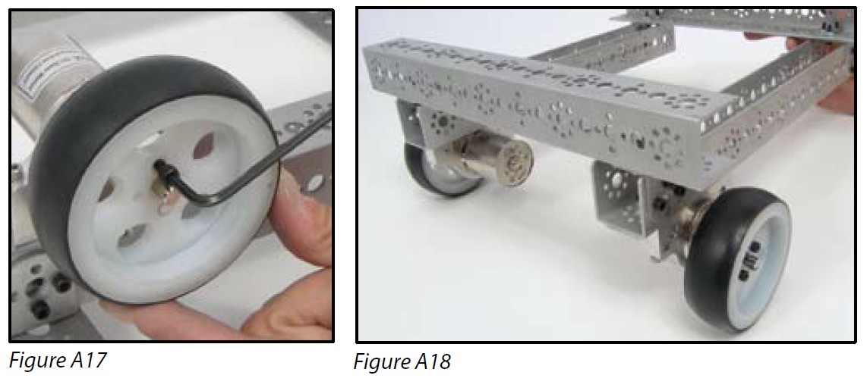
STEP 4) Attach the wheel to the hub with four 1/2" SHCSs
  (Figure A17).
  Flip over the chassis (Figure A18).
STEP 5) Repeat Steps 1-4 for the other side.

